Slide 1

COP 6731: Theory and Implementation of Database Systems
Query Processing and Optimization
Execution Plan

Slide 2
Outline
Execution Plan

Slide 3
Execution Plan
The execution plan is the result of the query optimizer’s attempt that may identify the most efficient way to access the dataset for the submitted SQL query.
Viewing an execution plan in the Oracle database involves two steps:
explain plan for — saves the execution plan in the PLAN_TABLE.
Display the execution plan.
SELECT * FROM table(dbms_xplan.display);
The DBMS_XPLAN package provides an easy way to display the output of the EXPLAIN PLAN command.

Slide 4
TIPs
Display the plan using the DBMS_XPLAN.DISPLAY table function.
SET LINESIZE 130
SET PAGESIZE 0
SELECT * FROM table (DBMS_XPLAN.DISPLAY);
The table function DISPLAY_CURSOR formats the execution plan for the last SQL statement executed by the session.
SELECT * FROM table(DBMS_XPLAN.DISPLAY_CURSOR);

Slide 5
Index and Table Access
INDEX UNIQUE SCAN
It performs the B-tree traversal only. The database uses this operation if a unique constraint ensures that the search criteria will match no more than one entry.
INDEX RANGE SCAN
It performs the B-tree traversal and follows the leaf node chain to find all matching entries.
INDEX FULL SCAN
Reads the entire index — all rows — in index order.

Slide 6
Index and Table Access
INDEX FAST FULL SCAN
Reads the entire index — all rows — as stored on the disk. This operation is typically performed instead of a full table scan if all required columns are available in the index. Similar to TABLE ACCESS FULL, the INDEX FAST FULL SCAN can benefit from multi-block read operations.

Slide 7
Index and Table Access
TABLE ACCESS BY INDEX ROWID
Retrieves a row from the table using the ROWID retrieved from the preceding index lookup.
TABLE ACCESS FULL
This is also known as full table scan. Reads the entire table — all rows and columns — as stored on the disk. Although multi-block read operations improve the speed of a full table scan considerably, it is still one of the most expensive operations. Besides high IO rates, a full table scan must inspect all table rows so it can also consume a considerable amount of CPU time.

Slide 8
Joins
NESTED LOOPS JOIN
Joins two tables by fetching the result from one table and querying the other table for each row from the first.
HASH JOIN
The hash join loads the candidate records from one side of the join into a hash table that is then probed for each row from the other side of the join.
MERGE JOIN
The merge join combines two sorted lists like a zipper.

Slide 9
Sorting and Grouping
SORT ORDER BY
Sorts the result according to the order by clause. This operation needs large amounts of memory to materialize the intermediate result (not pipelined).
SORT ORDER BY STOPKEY
Sorts a subset of the result according to the order by clause. Used for top-N queries if pipelined execution is not possible.

Slide 10
Sorting and Grouping
SORT GROUP BY
Sorts the result set on the group by columns and aggregates the sorted result in a second step. This operation needs large amounts of memory to materialize the intermediate result set (not pipelined).
SORT GROUP BY NOSORT
Aggregates a presorted set according the group by clause. This operation does not buffer the intermediate result: it is executed in a pipelined manner.
HASH GROUP BY
Groups the result using a hash table. This operation needs large amounts of memory to materialize the intermediate result set (not pipelined). The output is not ordered in any meaningful way.

Slide 11
Access and Filter-Predicates
Access predicate (“access”)
The access predicates express the start and stop conditions of the leaf node traversal.
Index filter predicate (“filter” for index operations)
Index filter predicates are applied during the leaf node traversal only. They do not contribute to the start and stop conditions and do not narrow the scanned range.
Table level filter predicate (“filter” for table operations)
Predicates on columns that are not part of the index are evaluated on table level. For that to happen, the database must load the row from the table first.

Slide 12
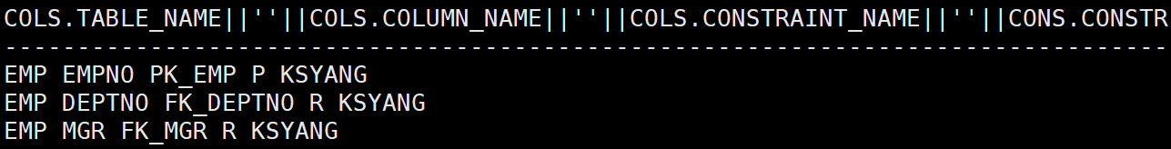
Constraints
SELECT COLS.table_name || ' ' || COLS.column_name || ' ' || COLS.constraint_name || ' ' || CONS.constraint_type || ' ' || CONS.owner
FROM all_constraints CONS, all_cons_columns COLS
WHERE CONS.constraint_name = COLS.constraint_name
AND CONS.owner = cols.owner
AND COLS.table_name = 'EMP'
ORDER BY COLS.position;

Slide 13
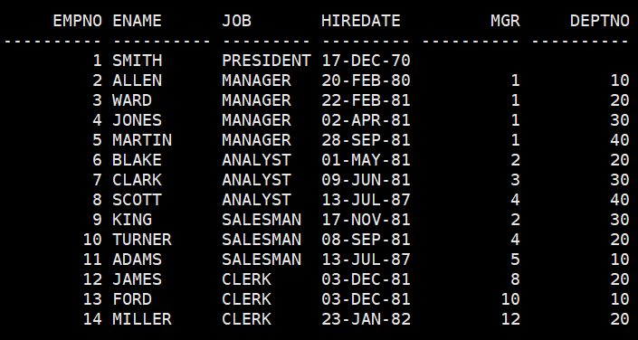
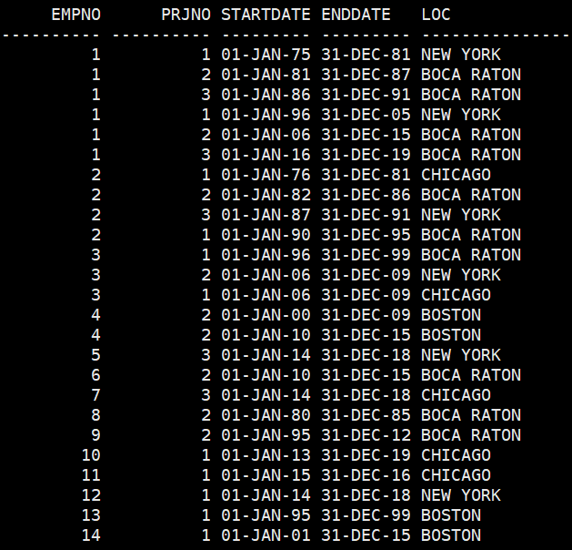
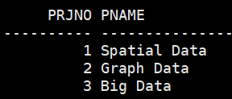
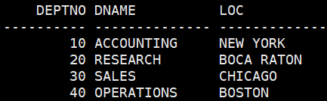
Table Examples
EMP
WORK_ON
PRJ
DEPT

Slide 14
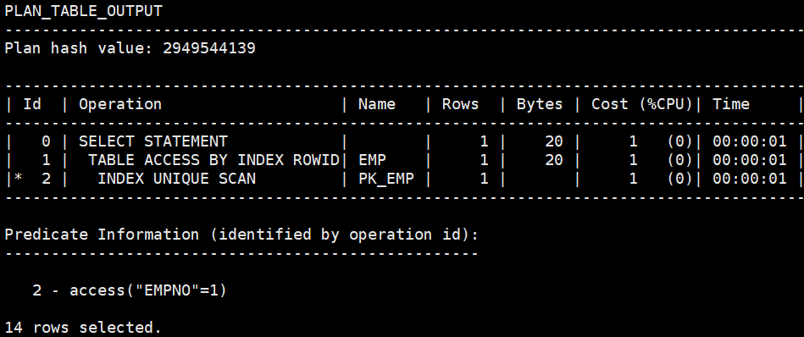
INDEX UNIQUE SCAN (Primary Key)
EXPLAIN PLAN FOR
SELECT E.ename
FROM emp E
WHERE empno = 1;
SELECT * FROM TABLE (DBMS_XPLAN.display);

Slide 15
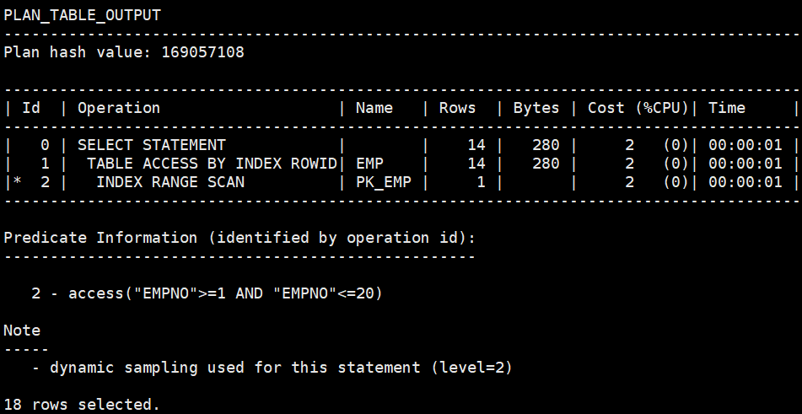
INDEX RANGE SCAN (Primary Key)
EXPLAIN PLAN FOR
SELECT E.ename
FROM emp E
WHERE empno BETWEEN 1 AND 20;
SELECT * FROM TABLE (DBMS_XPLAN.display);

Slide 16
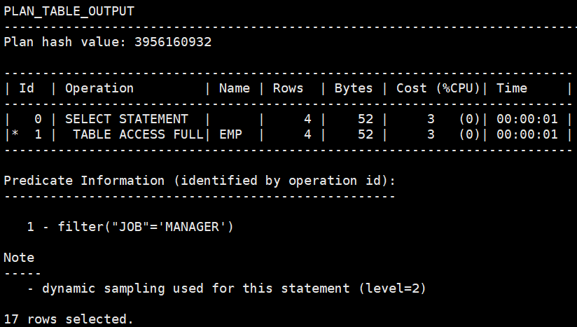
FULL TABLE SCAN (No Index)
EXPLAIN PLAN FOR
SELECT E.ename
FROM emp E
WHERE job = 'MANAGER';
SELECT * FROM TABLE (DBMS_XPLAN.display);

Slide 17
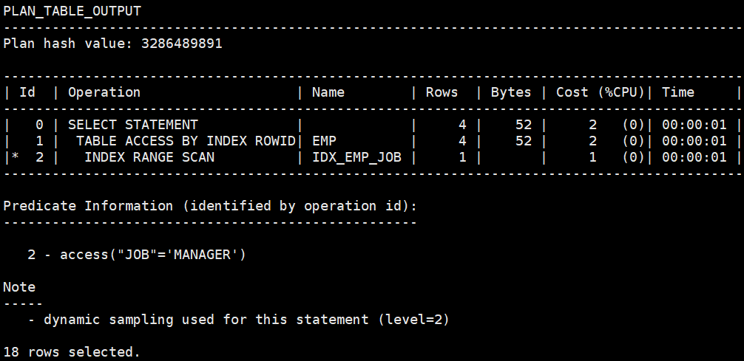
INDEX RANGE SCAN (Index)
CREATE INDEX IDX_EMP_JOB ON EMP (job);
EXPLAIN PLAN FOR
SELECT E.ename
FROM emp E
WHERE job = 'MANAGER';
SELECT * FROM TABLE (DBMS_XPLAN.display);

Slide 18
Optimizer Hints
Optimizer hints can be used with SQL statements to alter execution plans.
SELECT /*+ USE_MERGE(E D) */ E.id, E.name, D.name
FROM employees E, departments D
WHERE E.did = D. id;
SELECT /*+ USE_NL(l h) */ h.customer_id, l.unit_price * l.quantity
FROM order_items l, orders h
WHERE l.order_id = h.order_id;
SELECT /*+ USE_NL_WITH_INDEX(l item_product_ix) */ *
FROM order_items l, orders h
WHERE l.order_id = h.order_id
AND l.order_id > 3500;

Slide 19

NO_INDEX HINT (FULL TABLE SCAN)
CREATE INDEX IDX_EMP_JOB ON EMP (job);
EXPLAIN PLAN FOR
SELECT /*+ NO_INDEX(E IDX_EMP_JOB) */ E.ename
FROM emp E
WHERE job = 'MANAGER';
SELECT * FROM TABLE (DBMS_XPLAN.display);

Slide 20
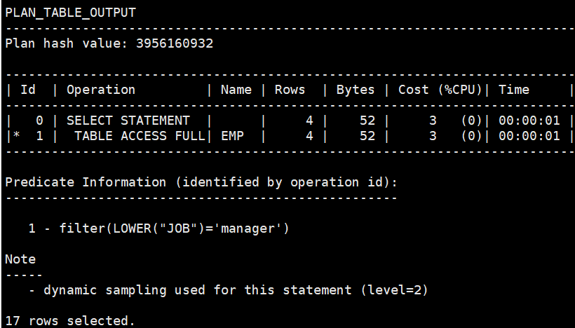
Functions (FULL TABLE SCAN)
CREATE INDEX IDX_EMP_JOB ON EMP (job);
EXPLAIN PLAN FOR
SELECT E.ename
FROM emp E
WHERE lower(job) = 'manager';
SELECT * FROM TABLE (DBMS_XPLAN.display);

Slide 21
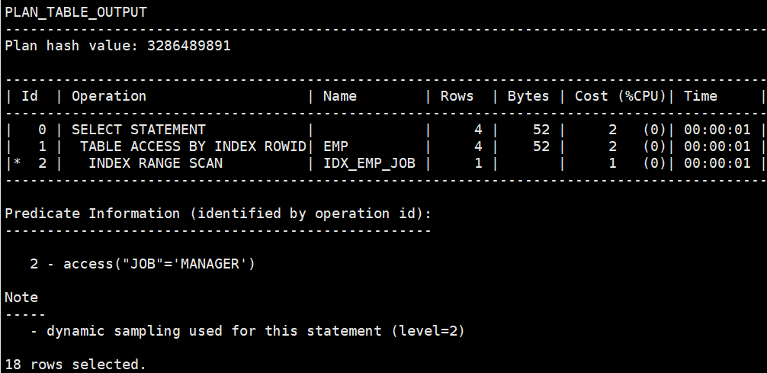
Functions (INDEX RANGE SCAN)
CREATE INDEX IDX_EMP_JOB ON EMP (job);
EXPLAIN PLAN FOR
SELECT E.ename
FROM emp E
WHERE job = upper('manager');
SELECT * FROM TABLE (DBMS_XPLAN.display);

Slide 22
INDEX RANGE SCAN is useful?
CREATE TABLE dummy_emp AS
SELECT level AS id, ' name_' || level AS name, ' address_' || level AS address, ' job_' || level AS job
FROM DUAL
CONNECT BY LEVEL <= 1000000;
CREATE INDEX IDX_DUMMY_EMP_ID ON DUMMY_EMP (ID);
EXPLAIN PLAN FOR
SELECT DE.id, DE.name, DE.address, DE.job
FROM dummy_emp DE
WHERE DE.id = 10;
SELECT * FROM TABLE (DBMS_XPLAN.display);
EXPLAIN PLAN FOR
SELECT DE.id, DE.name, DE.address, DE.job
FROM dummy_emp DE
WHERE DE.id <> 10;
SELECT * FROM TABLE (DBMS_XPLAN.display);

Slide 23
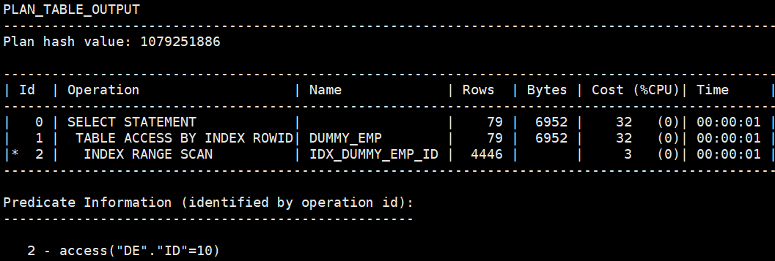
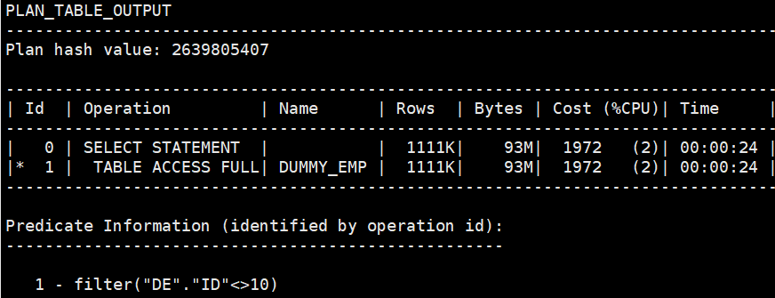
INDEX RANGE SCAN is useful?
EXPLAIN PLAN FOR
SELECT DE.id, DE.name, DE.address, DE.job
FROM dummy_emp DE
WHERE DE.id = 10;
EXPLAIN PLAN FOR
SELECT DE.id, DE.name, DE.address, DE.job
FROM dummy_emp DE
WHERE DE.id <> 10;

Slide 24
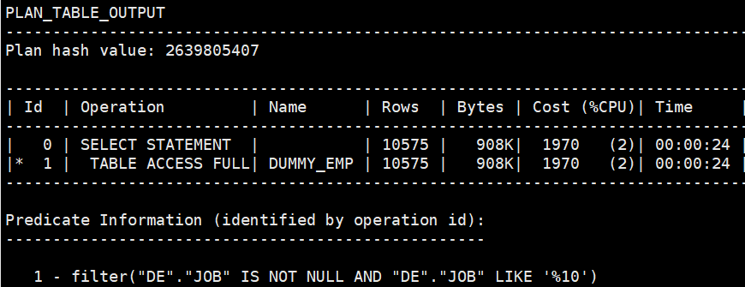
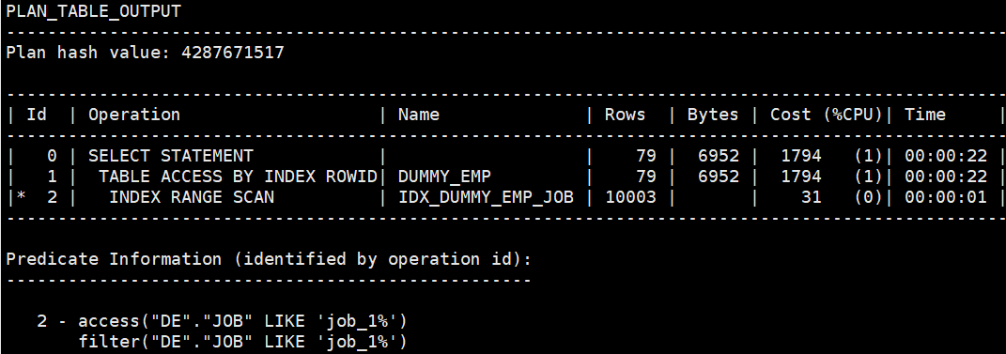
INDEX RANGE SCAN is useful?
CREATE INDEX IDX_DUMMY_EMP_JOB ON DUMMY_EMP (JOB);
EXPLAIN PLAN FOR
SELECT DE.id, DE.name, DE.address, DE.job
FROM dummy_emp DE
WHERE DE.job LIKE '%10';
EXPLAIN PLAN FOR
SELECT DE.id, DE.name, DE.address, DE.job
FROM dummy_emp DE
WHERE DE.job LIKE 'job_1%';

Slide 25
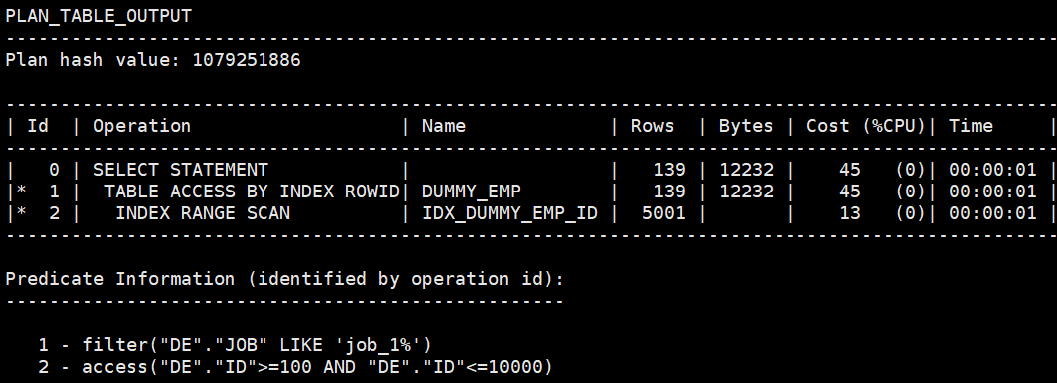
WHICH INDEX ?
EXPLAIN PLAN FOR
SELECT DE.id, DE.name, DE.address, DE.job
FROM dummy_emp DE
WHERE DE.job LIKE 'job_1%’;
AND DE.id BETWEEN 100 AND 10000;
SELECT * FROM TABLE (DBMS_XPLAN.display);

Slide 26
GATHER_PLAN_STATISTICS
Add the GATHER_PLAN_STATISTICS hint to the SQL statement
Setting the FORMAT parameter of DBMS_XPLAN.DISPLAY_CURSOR to ‘ALLSTATS LAST’
SELECT *
FROM TABLE (DBMS_XPLAN.display_cursor (format=>'ALLSTATS LAST'));

Slide 27
The JOIN operation
The join operation transforms data from a normalized model into a denormalized form that suits a specific processing purpose.
It processes only two tables at a time.
A SQL query with more tables requires multiple steps: first building an intermediate result set by joining two tables, then joining the result with the next table and so forth.

Slide 28
Pipelining Intermediate Results
The output of query produces an intermediate result. DBMS stores the intermediate result of the first join (i.e., materialization) before starting the next one.
Instead, databases use pipelining to reduce memory usage. That means that each row from the intermediate result is immediately pipelined to the next join operation — avoiding the need to store the intermediate result set.

Slide 29
GATHER_PLAN_STATISTICS Hint
Using the GATHER_PLAN_STATISTICS hint makes the optimizer gather the actual cardinalities in addition to the expected cardinalities in the execution plan. This can then be reported by the DISPLAY_CURSOR function if the format is set to 'ALLSTATS’.
The GATHER_PLAN_STATISTICS hint allows for the collection of extra metrics during the execution of the query. Specifically, it shows us the Optimizer's estimated number of rows (E-Rows) and the actual number of rows (A-Rows).

Slide 30
GATHER_PLAN_STATISTICS Hint
SELECT *
FROM TABLE (DBMS_XPLAN.display_cursor (format=>'ALLSTATS LAST'));
IOSTATS – assuming that basic plan statistics are collected when SQL statements are executed (either by using the GATHER_PLAN_STATISTICS hint or by setting the parameter statistics_level to ALL), this format shows IO statistics for ALL (or only for the LAST as shown below) executions of the cursor.
MEMSTATS – Assuming that PGA memory management is enabled (that is, pga_aggregate_target parameter is set to a non 0 value), this format allows to display memory management statistics (for example, execution mode of the operator, how much memory was used, number of bytes spilled to disk, and so on). These statistics only apply to memory intensive operations like hash-joins, sort or some bitmap operators.
ALLSTATS – A shortcut for ‘IOSTATS MEMSTATS
LAST – By default, plan statistics are shown for all executions of the cursor. The keyword LAST can be specified to see only the statistics for the last execution.

Slide 31
JOIN operations
Nested Loops
Hash Join
Sort Merge

Slide 32
Nested Loops
The nested loops join is the most fundamental join algorithm.
It works like using two nested queries: the outer or driving query to fetch the results from one table and a second query for each row from the driving query to fetch the corresponding data from the other table.

Slide 33
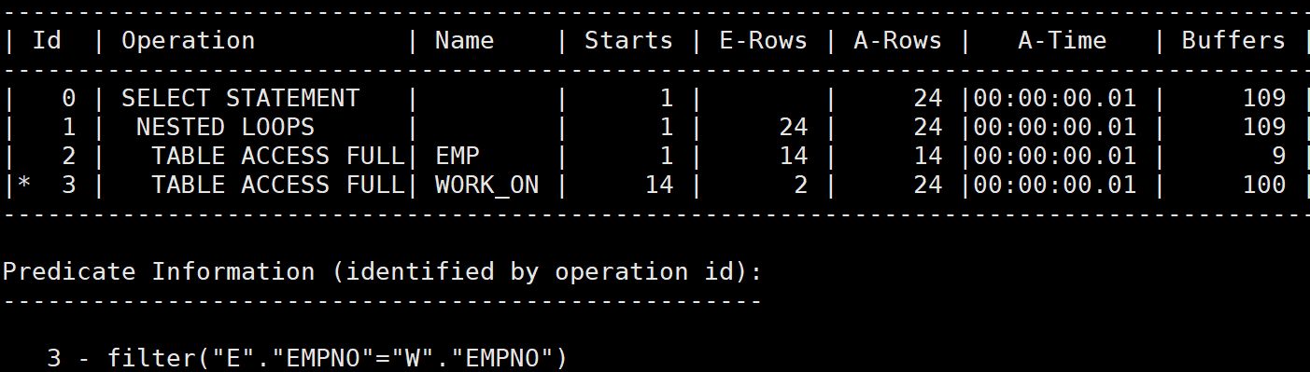
EXAMPLE
SELECT /*+ GATHER_PLAN_STATISTICS leading(E) USE_NL(E,W) */ *
FROM EMP E, WORK_ON W
WHERE E.empno = W.empno;
SELECT * FROM TABLE (DBMS_XPLAN.display_cursor (format=>'ALLSTATS LAST'));
The E-Rows and A-Rows columns are the estimated and actual row counts, respectively
The A-Time column reflects the time taken to execute the operation and all its descendants.

Slide 34
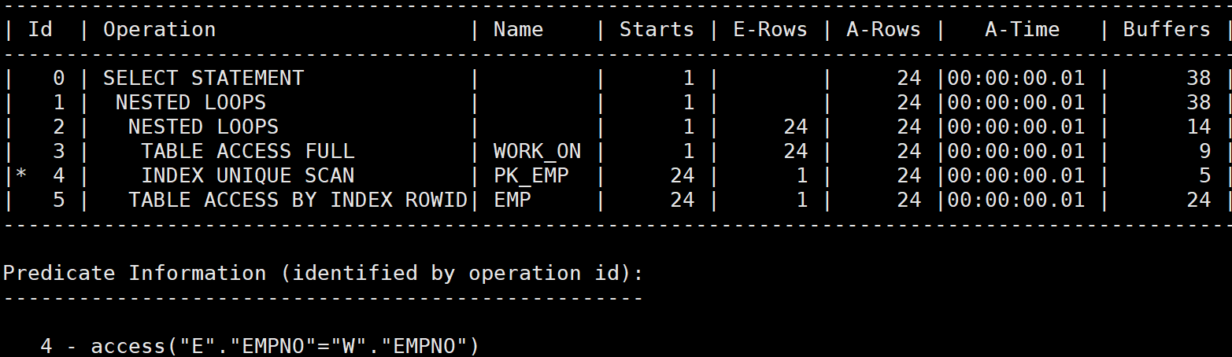
EXAMPLE
SELECT /*+ GATHER_PLAN_STATISTICS leading(W) USE_NL(W,E) */ *
FROM EMP E, WORK_ON W
WHERE E.empno = W.empno;
SELECT * FROM TABLE (DBMS_XPLAN.display_cursor (format=>'ALLSTATS LAST'));

Slide 35
Hash Join
A hash join do not need to index the join columns. Indexing join predicates doesn’t improve hash join performance.
It creates the hash table that acts as a temporary in-memory structure to avoid accessing the table many times.
Indexing a hash join is independent of the join order.
We can optimize hash join performance by minimizing the hash table size.

Slide 36
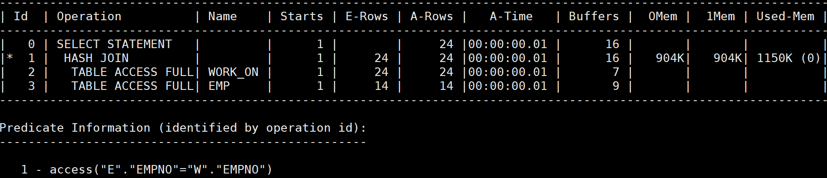
EXAMPLE
SELECT /*+ GATHER_PLAN_STATISTICS leading(W) USE_HASH(W,E) */ *
FROM EMP E, WORK_ON W
WHERE E.empno = W.empno;
SELECT * FROM TABLE (DBMS_XPLAN.display_cursor (format=>'ALLSTATS LAST'));

Slide 37
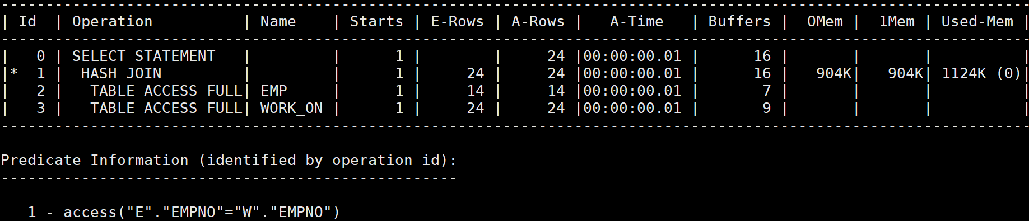
EXAMPLE
SELECT /*+ GATHER_PLAN_STATISTICS leading(E) USE_HASH(W,E) */ *
FROM EMP E, WORK_ON W
WHERE E.empno = W.empno;
SELECT * FROM TABLE (DBMS_XPLAN.display_cursor (format=>'ALLSTATS LAST'));

Slide 38
Sort Merge
Indexing the join predicates is useless.
The join order does not make any difference.
Although the sort-merge join performs very well once the inputs are sorted, it is hardly used because sorting both sides is very expensive.
The strength of the sort-merge join emerges if the inputs are already sorted.

Slide 39
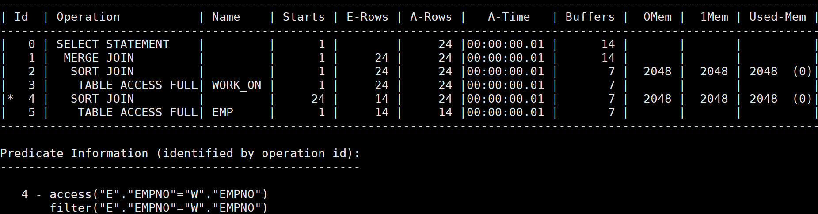
EXAMPLE
SELECT /*+ GATHER_PLAN_STATISTICS leading(W) USE_MERGE (W,E) */ *
FROM EMP E, WORK_ON W
WHERE E.empno = W.empno;
SELECT * FROM TABLE (DBMS_XPLAN.display_cursor (format=>'ALLSTATS LAST'));

Slide 40
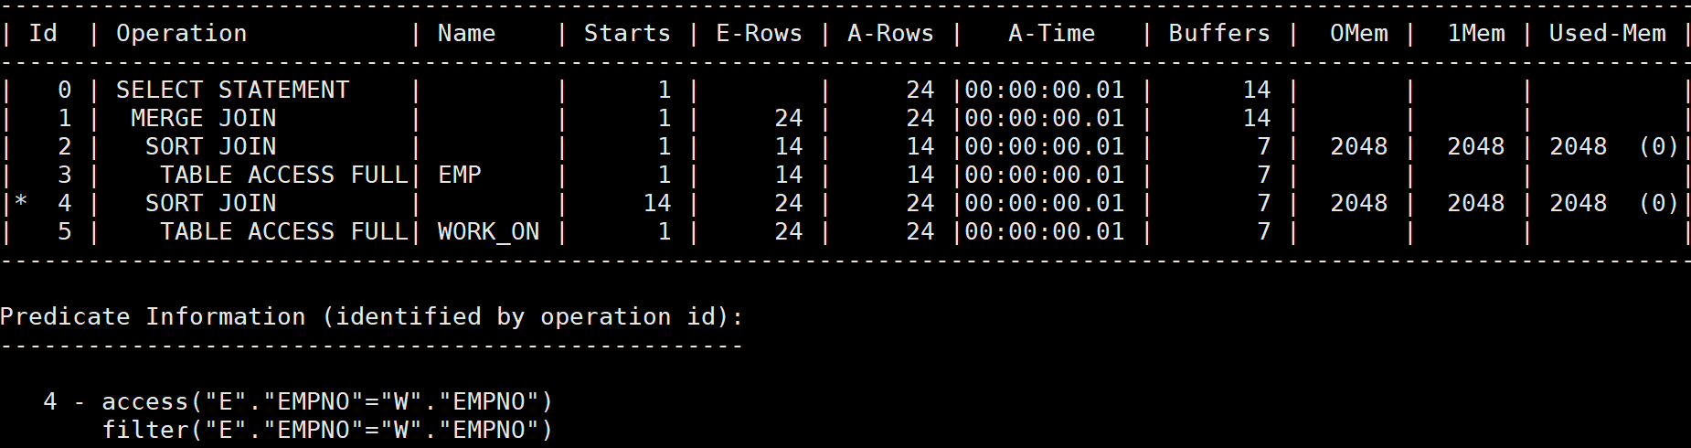
EXAMPLE
SELECT /*+ GATHER_PLAN_STATISTICS leading(E) USE_MERGE (W,E) */ *
FROM EMP E, WORK_ON W
WHERE E.empno = W.empno;
SELECT * FROM TABLE (DBMS_XPLAN.display_cursor (format=>'ALLSTATS LAST'));

Slide 41
Index-Only Scan
The index-only scan is one of the most powerful tuning methods of all.
Aggregating queries make good candidates for index-only scans.

Slide 42
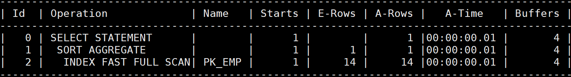
EXAMPLE
SELECT /*+ GATHER_PLAN_STATISTICS */ COUNT(E.empno)
FROM EMP E;
SELECT * FROM TABLE (DBMS_XPLAN.display_cursor (format=>'ALLSTATS LAST'));

Slide 43
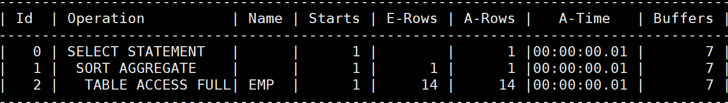
EXAMPLE
SELECT /*+ GATHER_PLAN_STATISTICS NO_INDEX(E PK_EMP) */ COUNT(E.empno)
FROM EMP E;
SELECT * FROM TABLE (DBMS_XPLAN.display_cursor (format=>'ALLSTATS LAST'));

Slide 44
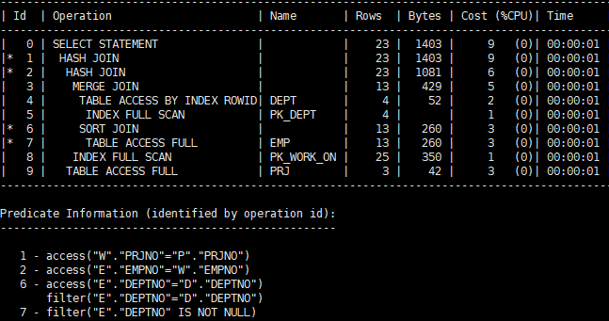
JOIN EXAMPLE I (DBMS_XPLAN.display)
EXPLAIN PLAN FOR
SELECT E.ename, E.job, W.startdate, P.pname, D.dname
FROM emp E, work_on W, prj P, dept D
WHERE E.empno = W.empno AND E.deptno = D.deptno AND W.prjno = P.prjno;
SELECT * FROM TABLE (DBMS_XPLAN.display);

Slide 45
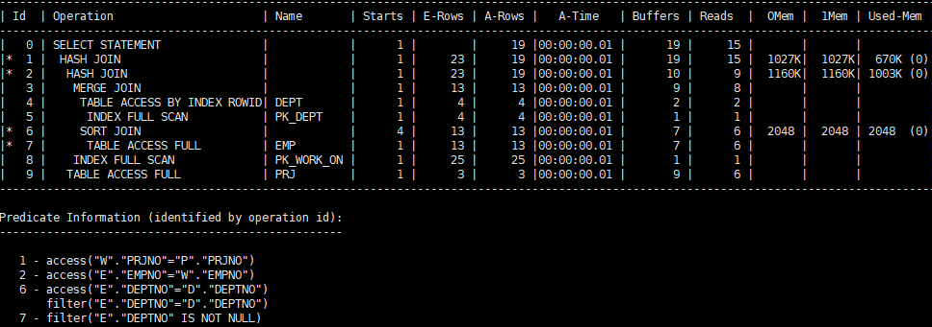
JOIN EXAMPLE I (DBMS_XPLAN.display_cursor)
SELECT /*+ GATHER_PLAN_STATISTICS */ E.ename, E.job, W.startdate, P.pname, D.dname
FROM emp E, work_on W, prj P, dept D
WHERE E.empno = W.empno AND E.deptno = D.deptno AND W.prjno = P.prjno;
SELECT * FROM TABLE (DBMS_XPLAN.display_cursor (format=>'ALLSTATS LAST'));

Slide 46
Query Tree
SELECT
0
Hash-join
(W.prjno = P.prjno)
1
Hash-join (E.empno = W.empno)
2
9
PRJ (Table Full Scan)
Sort-merge Join
(D.deptno = E.deptno)
3
8
PK_WORK_ON
(Index Full Scan)
DEPT
(Table Access)
4
6
SORT
5
7
PK_DEPT
(Index Full Scan)
EMP (Table Full Scan)

Slide 47
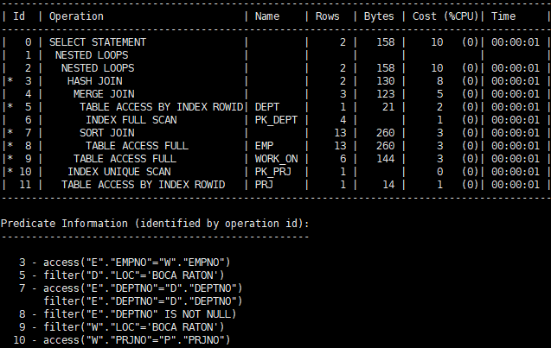
JOIN EXAMPLE II (DBMS_XPLAN.display)
EXPLAIN PLAN FOR
SELECT E.ename, E.job, W.startdate, P.pname, D.dname
FROM emp E, work_on W, prj P, dept D
WHERE E.empno = W.empno AND E.deptno = D.deptno AND W.prjno = P.prjno
AND W.loc = 'BOCA RATON’ AND D.loc = 'BOCA RATON';
SELECT * FROM TABLE (DBMS_XPLAN.display);

Slide 48
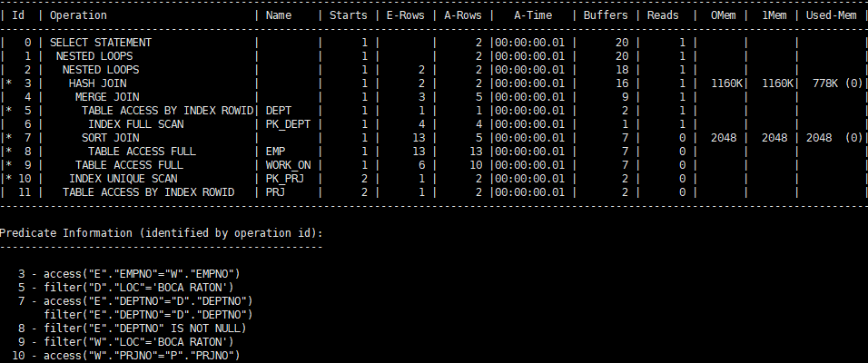
JOIN EXAMPLE II (DBMS_XPLAN.display_cursor)
SELECT /*+ GATHER_PLAN_STATISTICS */ E.ename, E.job, W.startdate, P.pname, D.dname
FROM emp E, work_on W, prj P, dept D
WHERE E.empno = W.empno AND E.deptno = D.deptno AND W.prjno = P.prjno
AND W.loc = 'BOCA RATON’ AND D.loc = 'BOCA RATON';
SELECT * FROM TABLE (DBMS_XPLAN.display_cursor (format=>'ALLSTATS LAST'));

Slide 49
Query Tree
0
SELECT
Nested-loop Join (W.prjno = P.prjno)
1
Nested-loop Join
(W.prjno = P.prjno)
2
11
PRJ
(Table Full Scan)
Hash Join
(E.empno = W.empno)
3
10
PK_PRJ
(Index Unique Scan)
Sort-merge Join
(E.deptno = D.deptno)
4
9
WORK_ON
(Table Full Scan)
DEPT
(Table Scan)
SORT
5
7
6
8
PK_DEPT
(Index Full Scan)
EMP
(Table Full Scan)

Slide 50
Summary
Execution Plan

